Slide 1
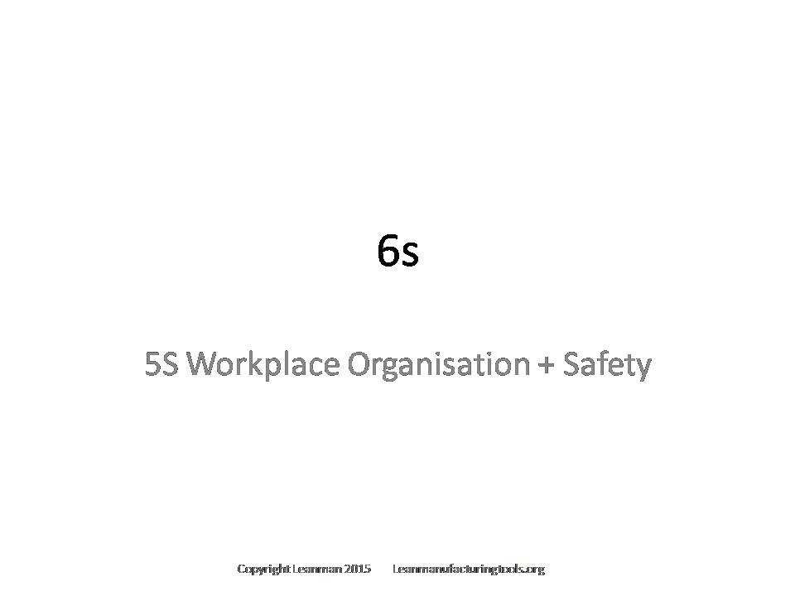
For a Customized or Editable Version of This Presentation Contact Through Leanmanufacturingtools.org

Slide 2
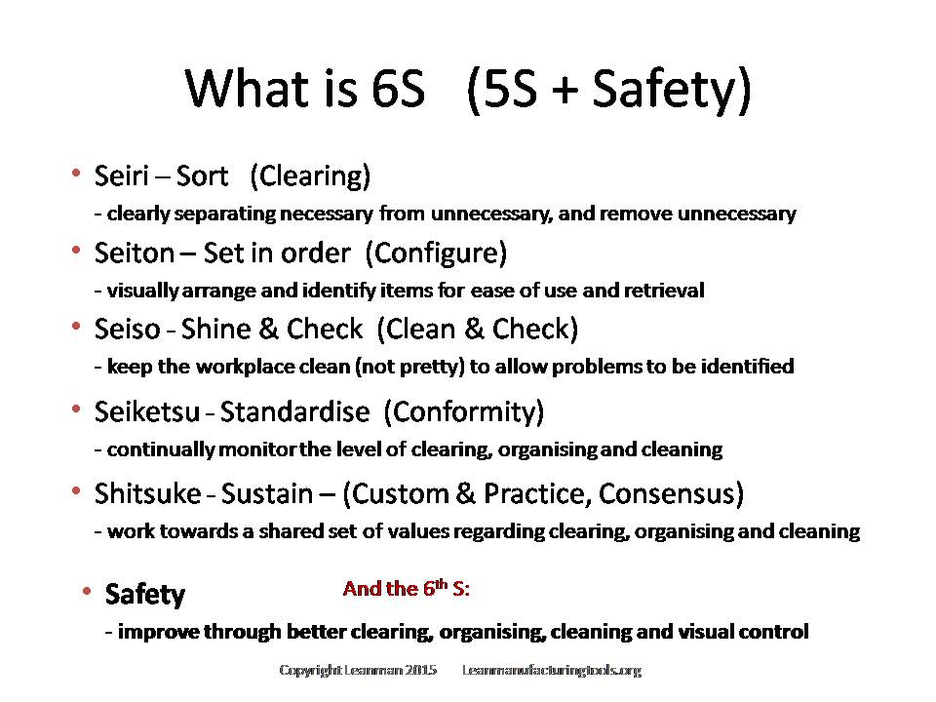

Slide 3
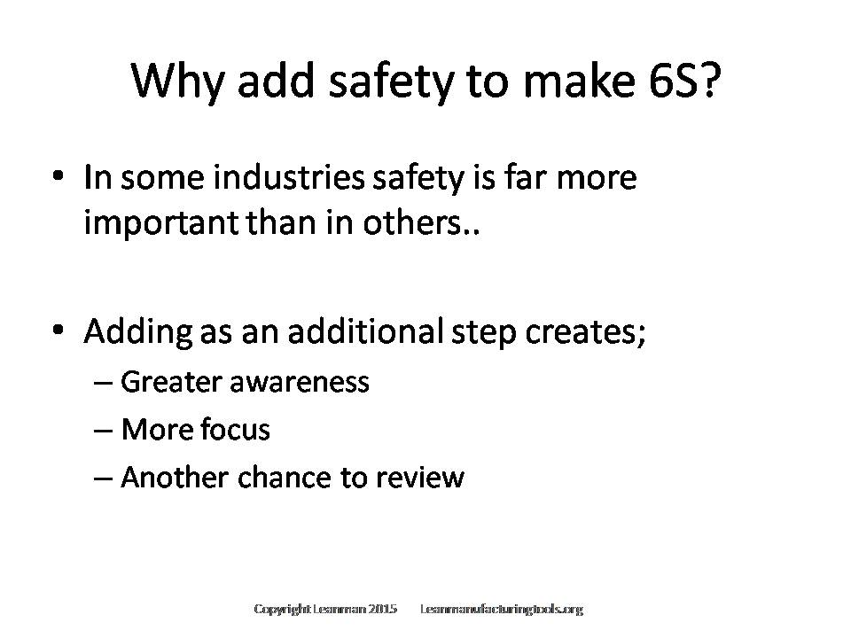

Slide 4
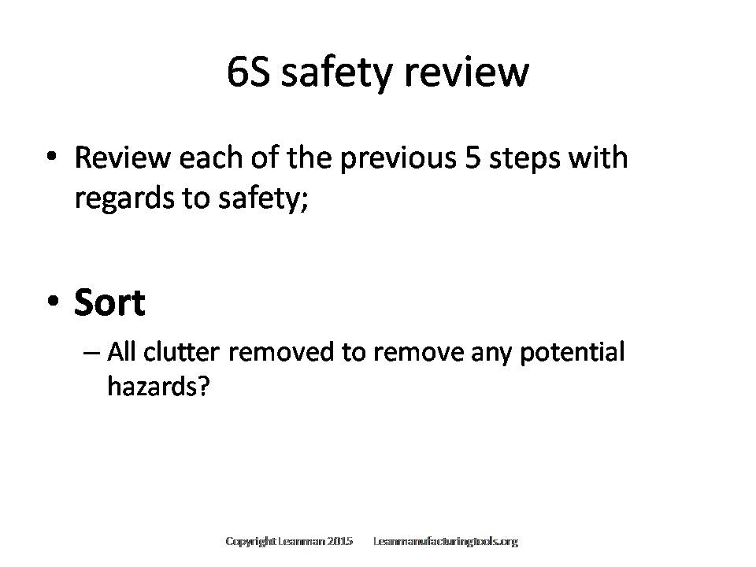

Slide 5
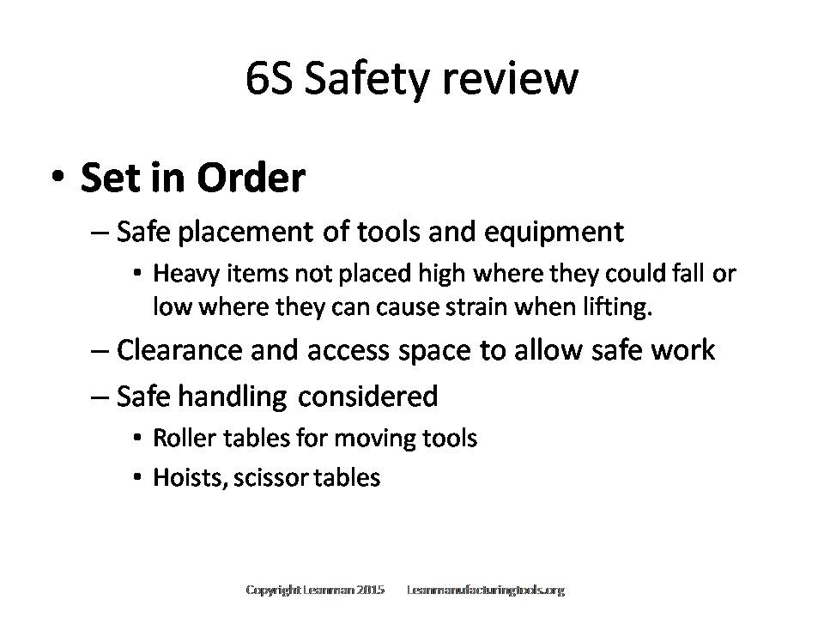

Slide 6
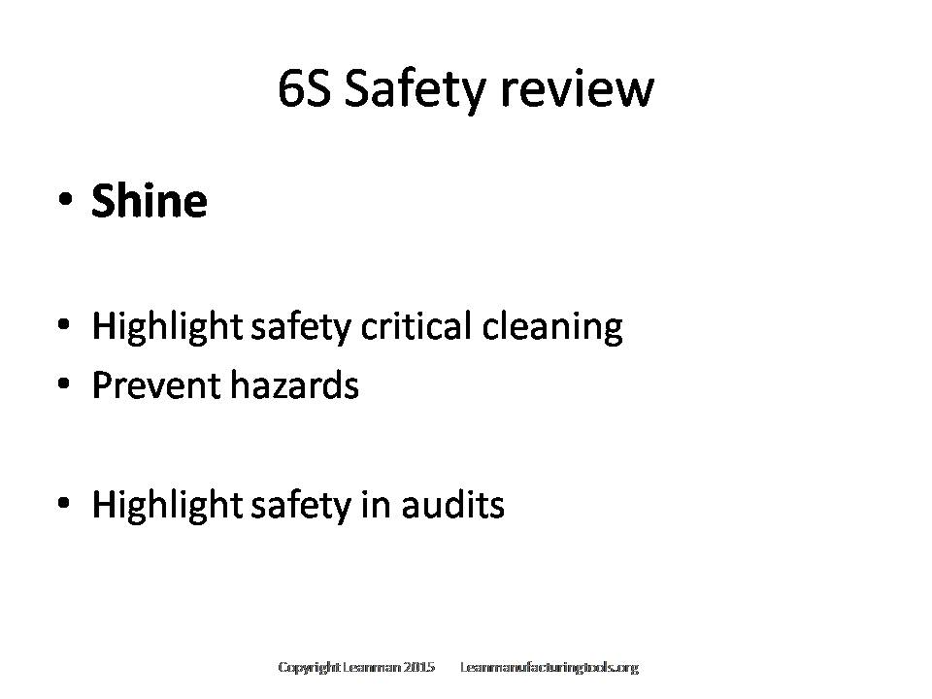

Slide 7
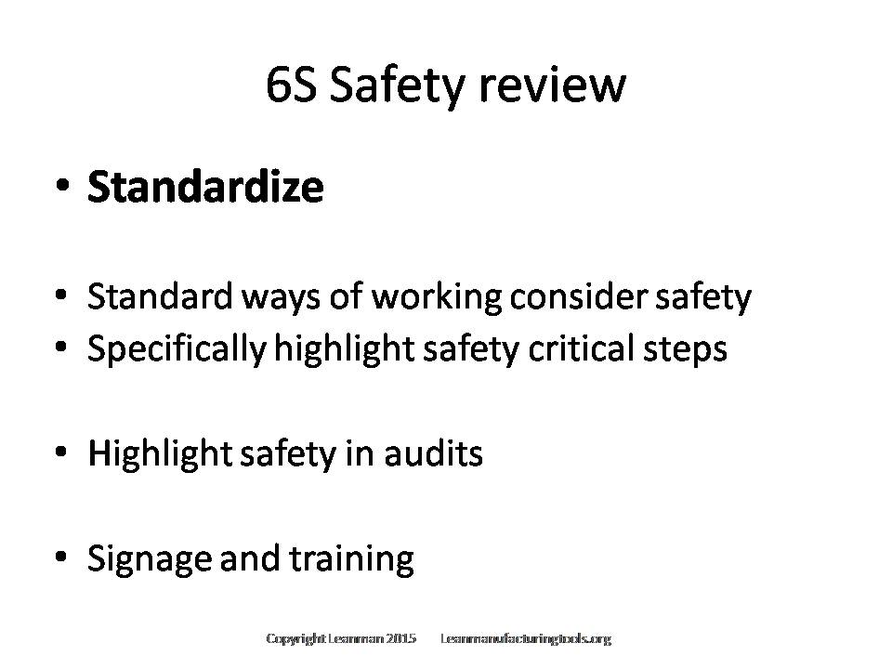

Slide 8
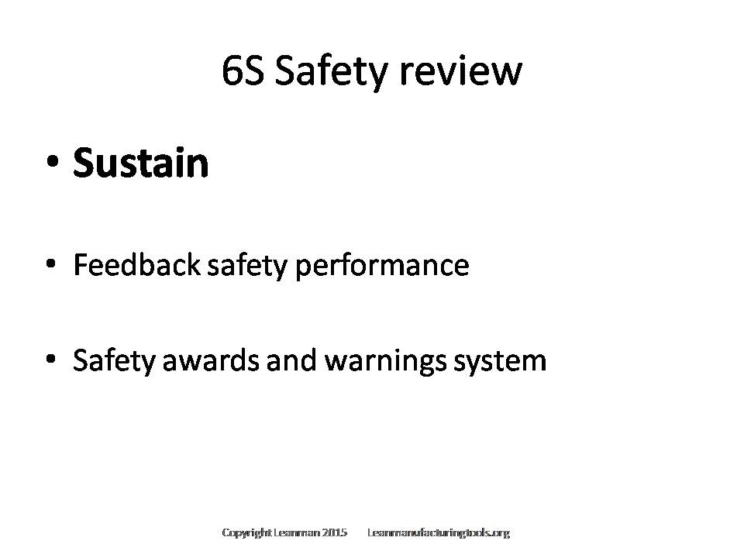

Slide 9
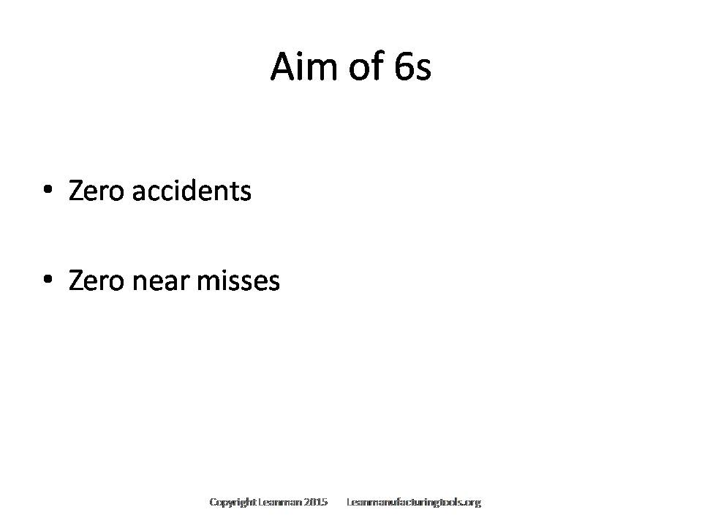

Slide 10
Copyright and Disclaimer
Any commercial use of this presentation and the content therein is prohibited without prior permission. Requests for permission to use can be made through the contact page of http://leanmanufacturingtools.org/contact-page/
This presentation is for personal use only and cannot be reproduced or circulated by anyone other than www.leanmanufacturingtools.org
Content may be quoted or reproduced for private and educational assignments as long as a proper citation is given referring leanmanufacturingtools.org
The information within this presentation and website are for information purposes only and any action taken is at your own risk.

